Slide 1
Finding a Job

Slide 2
Before you start…
Take a short class
Relevant Technical Skill
Volunteer
Similar organization
Take a temporary position
Experience and transferrable skills
Follow stories from your industry or field
Stay current to show you’re serious
Network
Get your foot in the door
Unpublicized Openings

Slide 3
Where to Look For Jobs
Idealist.org
Non profit and non governmental jobs and internships
USAJobs.gov
Positions within the federal government
Jobs for Jacks
Job search database accessible to NAU students and alumni
LinkedIn.com
Used both by individual’s seeking employment, and organizations seeking candidates
Internships.com

Slide 4
Identify Professional References
People who feel confident saying wonderful things about you
Coworkers, supervisors, internships, volunteer commitments, professors
3 to 5 people
Be sure to ask first
Make sure they feel comfortable giving you a strong recommendation
Let them know in advance

Slide 5
Do Your Research
Find out more about the company’s culture, strengths and weaknesses
Glassdoor.com
Work climate, opportunities to grow, pay, etc

Slide 6
Your Job Qualifications
What makes you a great fit for this job vs. other similar companies?
What are the most relevant experiences that have helped you prepare for a certain type of job
Jobs
School
Volunteer Service

Slide 7
External Factors
Location- Is there a geographic location in which you want to work or don’t want to work?
Employer values- In addition to finding the right job description, is it important to you to also find an employer with a certain type of mission?
Company size- Is it important for you to work in a large, well-established organization or do you prefer new or smaller enterprises?

Slide 8
Resumes and Cover Letters

Slide 9
Resume Building
A resume is a simple, clean summary of your accomplishments
Only include what’s relevant to the job opening
Schooling
Job experience
Special Skills
Utilize strong action verbs
Communicated, Presented, Oversaw, Advertised, Analyzed, etc

Slide 10
Resume Rules
Keep your resume to one page (two if absolutely necessary)
No full sentences
Leave out jobs from 10-15 years ago
Keep it concise – use strong words
Always check for typo’s

Slide 11
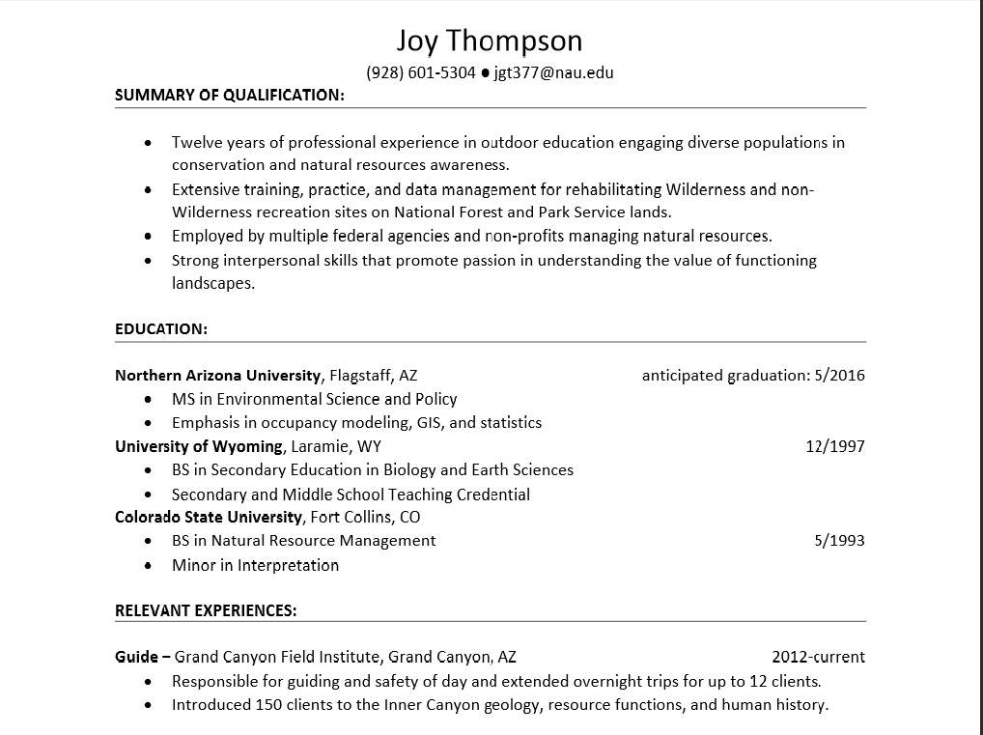

Slide 12
Cover Letters
Your chance to talk about your qualifications in length
First Paragraph – Personalize
Why are you interested?
Body Paragraph – Undeniable fact
I led a team of four international volunteers to assist a local women’s organization in remodeling a preschool.
I am very adaptable to new environments and situations, and enjoy the challenge of working with a diverse team to accomplish common goals.
Employers are evaluating your communication ability through your writing.
Double check for typos and flow

Slide 13
Interview Skills

Slide 14
Types of Interviews
Traditional – Asks a series of questions about the candidate that have straightforward answers
Screening – Used to ensure candidates meet basic qualification requirements (Done over phone, Skype,etc)
Behavioral – Designed to understand how a candidate has behaved in the past as an indicator of how the candidate will perform in the future
Group – Used to understand how a candidate behaves and stands out among peers

Slide 15
If time, show part of ted talk
https://www.ted.com/talks/amy_cuddy_your_body_language_shapes_who_you_are?language=en

Slide 16
Before the interview
Research the company
Know what position you’re applying for and why you’re interested
Prepare responses to common interview questions
Tell me a little about yourself
How did you hear about this position?
Why should we hire you?
Prepare a set of examples you can use to demonstrate experience
Think of questions you want to ask

Slide 17
Interview Etiquette
Print extra resumes
Practice interview questions with someone
Plan what you wear – “Dress to impress”
Professional Attire, even if the workplace is casual dress
Arrive 15 minutes early (no earlier)
Greet all staff members, not just the hiring manager
Follow up with a thank you card addressed to the interviewer
Don’t restate qualifications, just thank them for the opportunity

Slide 18
During the Interview
Stay calm and composed
Take breaths when needed
It’s ok to pause for thought
Project a positive attitude
Give honest and concise answers
Use tone of voice and body language to convey your interest

Slide 20
Tricky Questions
Why do you want to work here?
Show that you’ve done your homework on the company
What are your strengths?
Fine-tune your strengths to the job opening ahead
What are your weaknesses?
Talk about a time when you had to overcome a challenge
What you learned
How it helped you grow

Slide 21
Awkward situations
When talking about these subjects, try to focus on the positive
Negative questions
If you don’t have an answer
Gaps in employment history
Lack of work experience
Reason for leaving last job
Etc

Slide 22
After the interview
Ask when the employer will be making a hiring decision
If you want the job, say so! (But don’t overdo it)
If you don’t get the job, keep refining your story and practicing.
Interviews are a great learning experience

