Slide 1
Financial Literacy
COL 130
Alexa Greer

Slide 2
The Money Disconnect
Credit cards, Debit Cards, Checks
No knowledge required for Credit Cards
Big banks love financial illiteracy

Slide 3
Ultimately…
Poor money management = increased debt/negative financial outcomes

Slide 4
How would you describe your current financial outlook?
Hopeless
Overwhelming debt
Vulnerable
Unable to change your financial situation
Pessimistic
Believe your job, the economy, debt, money management skills hold you back – no matter what you try
Tolerable
Barely getting by
Paying bills
Making minimum payments
Optimistic
Current w/ bills
Using personal saving plan
Building emergency fund
Stable
Reduced debt
Have emergency fund
Building assets
Improving credit

Slide 5
Creating a Spending Plan
30% Housing
20% Transportation
10-20% Food
10% Insurance
20-30% Taxes, Entertainment, Healthcare, etc
Debt should be <15% at all times
Try to invest or save 5%

Slide 6
Weekly Spending Chart
MON | TUES | WED | THUR | FRI | SAT | SUN
$15.00 on gas |  | $30.31 Groceries |  | $21.45 Fratelli’s Pizza |  | $4.50 Burger King Breakfast
$4.21 Starbucks | $7.85 Mcdonalds |  | $15.60 Amazon |  | $6.00 Parking Garage

Slide 7
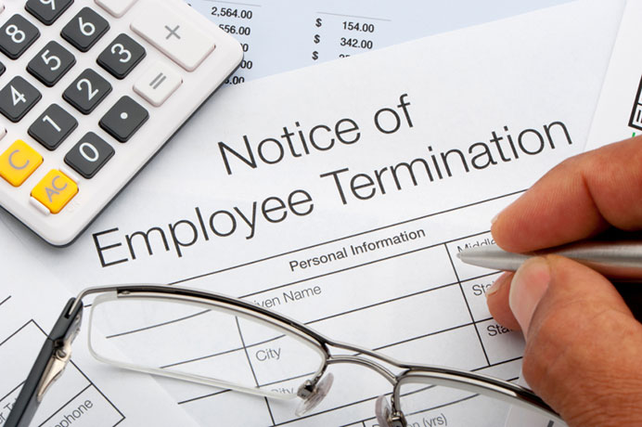
Emergency Fund
Emergency funds are there to cover:
Job loss
Injury
Have enough money saved to cover 4-7 months of income
Treat it like a bill
Start out with a small goal

Slide 8
Where to store?
Separate bank account to separate emergency funds from everything else
Easy to get to
Consider a money market account
Allows withdrawals only at certain minimum levels
Short-term certificates of deposit
You'll earn more interest than a typical savings account
Only if you can live without the money

Slide 9
Saving Techniques
Use nothing but cash
Envelopes for each category
52 Week Challenge
Week 1 – Save $52
Week 2 – Save $51
…Week 51 – Save $2
…Week 52 – Save $1
By the end of the year $1378 will be saved

Slide 10
Cutting Costs
Renegotiate everything.
Ask for better rates
Lower interest credit card interest rates
Ask your insurance company for a rate reduction.
If anybody balks, shop around.
Transfer monthly savings to your savings account each month

Slide 11
Credit Scores

Slide 12
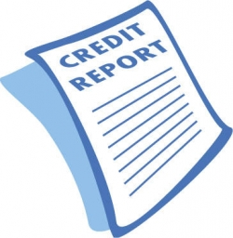
What is a credit score?
A summary that distills all the information in your credit report into a single number
Sometimes called a FICO score
Credit scores fall between 600 - 850

Slide 13
Credit Score Meanings
Over 850 | Excellent
750 –849 | Very Good to Excellent
700 – 749 | Good to Very Good
650 – 699 | Fair to Good
600 – 649 | Poor to Fair
Below 600 | Very poor to poor
You can get a free credit score assessment every 12 months

Slide 15
Determining Factors
10% - Types of Credit
10% - Recent Credit
15% - Length of Credit History
35% Paying on Time
30% - Keep Balance Low

Slide 16
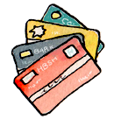
Credit Tips
Use credit cards only for emergencies
Pay for everything with credit, but budget ahead of time
Sear’s Card, Dillard’s card
Think long term

Slide 17
Investing

Slide 18
Investing for Students
Saving is a short term activity
Investing is a long term activity

Slide 19
Investing
Your investments should be:
Reasonably safe
Make interest
Your savings are about safety
Don’t put all your eggs in one basket
Keep it simple

Slide 20
Investing Basics
Your investment should make more that 3%-4% annually
Keep up with inflation
Risk vs. Return
Investments that pay higher interest rates have higher risk associated with them

Slide 21
What is unnecesary risk?
Someone bets you $100 that a coin toss will land on heads – 50% chance of doubling your money
Someone bets you $100 that a coin toss will land on heads twice – 25% chance of doubling your money
You are taking on additional risk for no additional return

Slide 22
What’s right for me?
Only YOU can answer what an acceptable risk is to you.
How much? How long?
$10,000 investment drops to $7,500?
$10,000 stays at $10,000 for three years?
Define your own tolerance, and find an investment to match

Slide 23
Mutual Funds
Brings together hundreds of thousands of small investors and pools resources
You invest $100 out of the millions of dollars in the total fund
Make sure your fees are minimal

Slide 24
Index Funds
Follow the market
Don’t need to be closely watched
Lower costs, provide high results over time
Only about 25% of professionally managed mutual funds actually provide a higher return than their market index.

Slide 25
Traditional & Roth IRA’s
Avoid taxes on the money you put in now
Once you are 59 ½, you take it out and pay taxes
You’ll be in a lower tax bracket once retired
Taxes will cost less in the future
Still pay current taxes – but you don’t pay taxes when you take it out
You will be in the same or higher tax bracket when you retire
Taxes will cost more in the future
Traditional IRA
Roth IRA

Slide 26
The Cost of Waiting
Retirement starting at 22 years old | $525, 454
Retirement starting at 25 years old | $412,049
Total Cost of financial ignorance | $113,403

Slide 27
To Recap
Saving
Building a budget
Credit Scores
Investing

Slide 28
Thank you very much!
Any questions?

