Slide 1
Budgeting 101
Alexa Greer

Slide 2
The Money Disconnect…
How many of you use debit cards?
How many of you balance your checkbooks?
How many of you have direct deposit set up?
A disconnect from money encourages less responsible spending

Slide 3
Your relationship with money
Hopeless
Overwhelmed by debt
Feeling vulnerable
Unable to change your financial situation due to lack of knowledge or hope
Pessimistic
Not hopeful about current job/lack thereof
Belief that making minimum loan payments won’t help
Belief that your money management skills prevent you from improving your financial situation
Tolerable
“Getting by”
Living paycheck to paycheck
No savings or emergency fund

Slide 4
Ideally…
Optimistic
Current with bills
Reducing debt/student loans
Building emergency fund
Stable
Using personal spending plan
Emergency fund
Managing money rather than money managing you
Growing savings

Slide 5
Spending Plan
Calculate Income
30% Housing
20% Transportation
10-20% Food
10% Insurance
20-30% Taxes, Entertainment, Healthcare, etc
No more than 15% debt!
Try to invest/save at least 5% monthly

Slide 6
Savings Goals
Savings goals should be…
S – Specific
M – Measurable
A – Attainable
R – Relevant
T – Time-Specific
Set a goal to put $250 into an emergency fund!
Set a goal to save for a fun day trip

Slide 7
Weekly Savings Tracker
MON | TUES | WED | THUR | FRI | SAT | SUN
$15.00 on gas |  | $30.31 Groceries |  | $21.45 Fratelli’s Pizza |  | $4.50 Burger King Breakfast
$4.21 Starbucks | $7.85 Mcdonalds |  | $15.60 Amazon |  | $6.00 Parking Garage

Slide 8
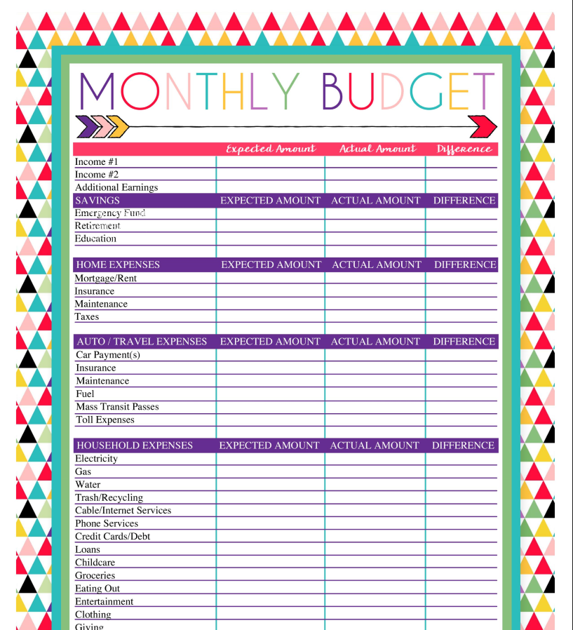

Slide 9
Cutting Back
Start saving your receipts in a plastic case
Establish which areas can be cut down
Identify Wants vs. Needs
Apps like Mint.com can analyze your spending through your bank account
You can set a budget
The app will notify you if you go over so you can tighten other areas to compensate

Slide 10
Cutting Costs
Renegotiate everything.
Call up all your service providers, and ask for better rates.
Tell your bank you want to pay less interest on your credit card
Ask your insurance company for a rate reduction.
If anybody balks, shop around.

Slide 11
Cutting Costs
Get rid of regular reoccurring expenses
Unused gym memberships
Unused Netflix/Hulu Accounts
Costco memberships, etc
Avoid Fees
Return library books on time
Check your bank for “hidden” fees
Renew license and registration on time

Slide 12
Cutting Costs
Negotiate new due dates for bills if necessary
Find a date that works well with your pay schedule
Set bills to be taken out immediately after receiving your paycheck (?)
Avoid bottled water
Avoid buying coffee and soda when you’re out
Use coupons
Try buying groceries in bulk
Notes:
Can we meet again on Thursday to talk about budget stuff?

